Slide 1


IMMUNIZATION
Class- Theory
Batch- 2018
Dated 29 may,Time- 2 pm to 4 pm
Dr. Dinesh kumar
Tutor, Dept of Community Medicine Shrikrishna Medical College & Hospital

Slide 2
SESSION OUTLINE
History
What is immunization
Why immunization
How vaccine works
Types of Vaccines
Universal Immunization Programme
National Immunization schedule
Cold chain and vaccines
Mission Indradhanush
Achievements

Slide 3
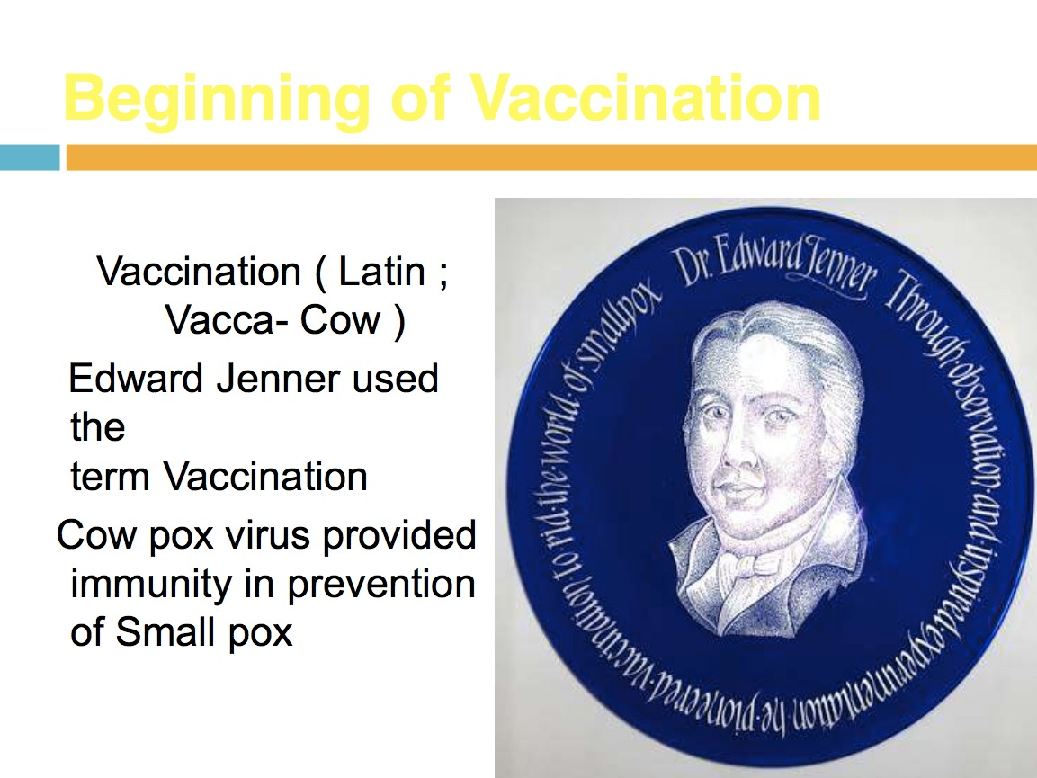

Slide 4
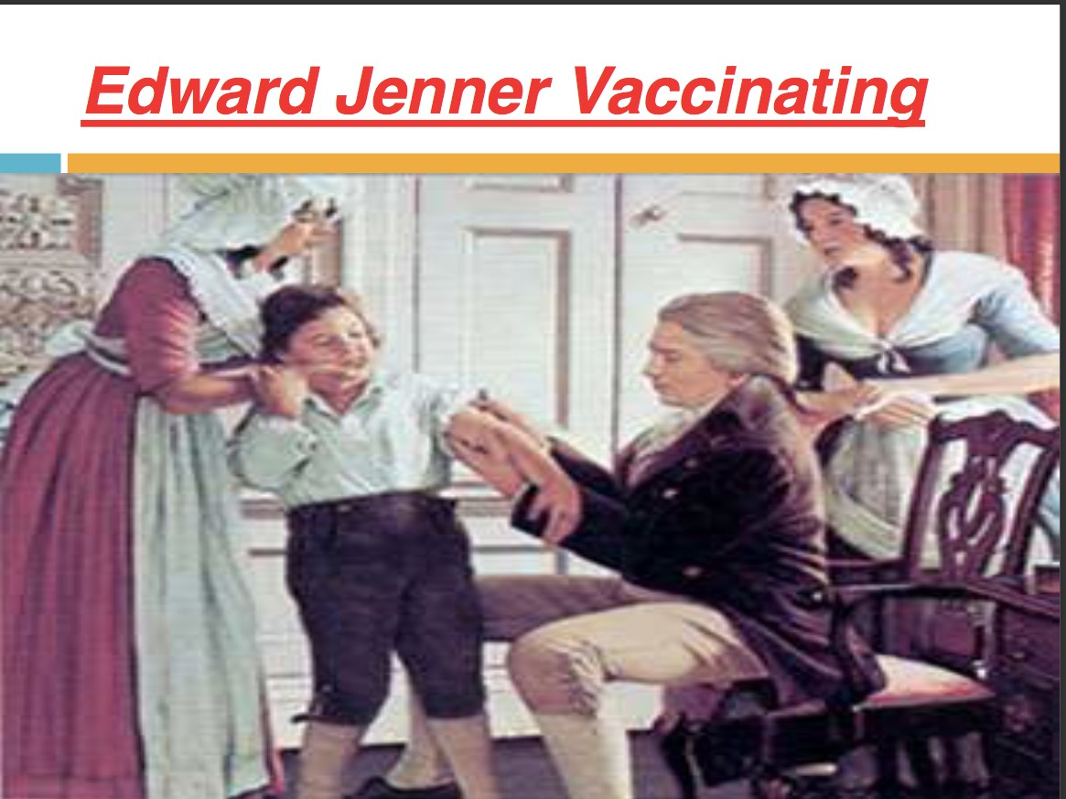
BEGINNING OF VACCINATION

Slide 5

Contd..
In 1796, Jenner took pus from the hand of a milkmaid with cowpox, scratched it into the arm of an 8-year-old boy.
Six weeks later inoculated the boy with smallpox, afterwards observing that he did not catch smallpox.
Jenner extended his studies and in 1798 reported that his vaccine was safe in children and adults.
• Six Killer disease
• • Poliomyelitis, • Tuberculosis, • Diphtheria,
• • Pertussis, • Tetanus
• Measles

Slide 6
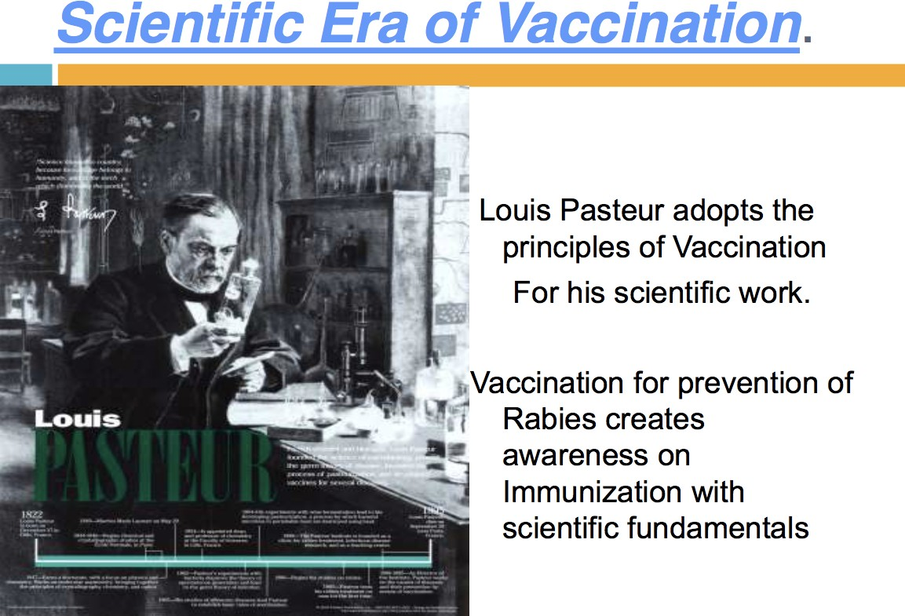

Slide 7
IMMUNIZATION
Immunization is a process of protecting an individual from a disease through introduction of live attenuated, killed or organisms or antibodies in the individual system.
Immunization is the process of protecting an individual by active or passive method.
The immunizing agents are
Vaccines, Immunoglobulins and antisera

Slide 8
ACTIVE VS PASSIVE IMMUNIZATION
Active
Killed or live attenuated organism injected which can induce immune response
Long term
Immune system plays role
Ex-Hepatitis B vaccine, DPT, Inactivated polio vaccine, Measles-rubella (MMR) combined vaccine
Passive
Transfer of antibodies
Short term
No role of immune system
Ex- Anti Tetanus, serum, Anti Rabies immunoglobulin etc

Slide 9
WHY IMMUNIZATION
Prevention of deadly and debilitating diseases.
Keeps child from suffering through a
preventable illness.
Less doctor visits
No hospitalization

Slide 10
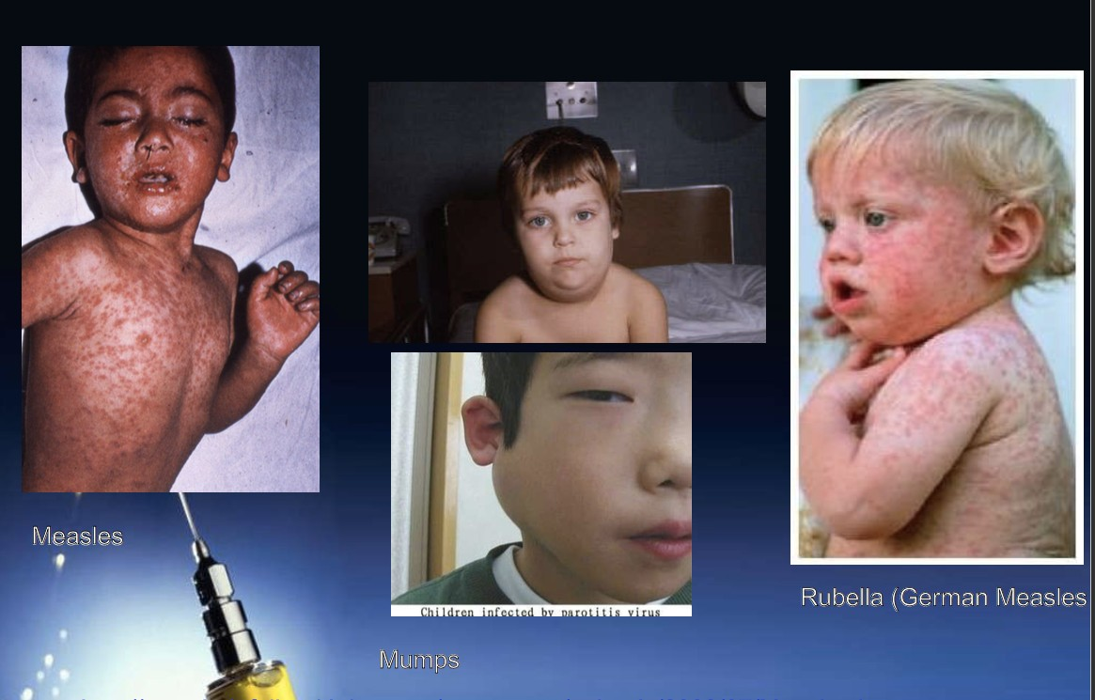

Slide 11
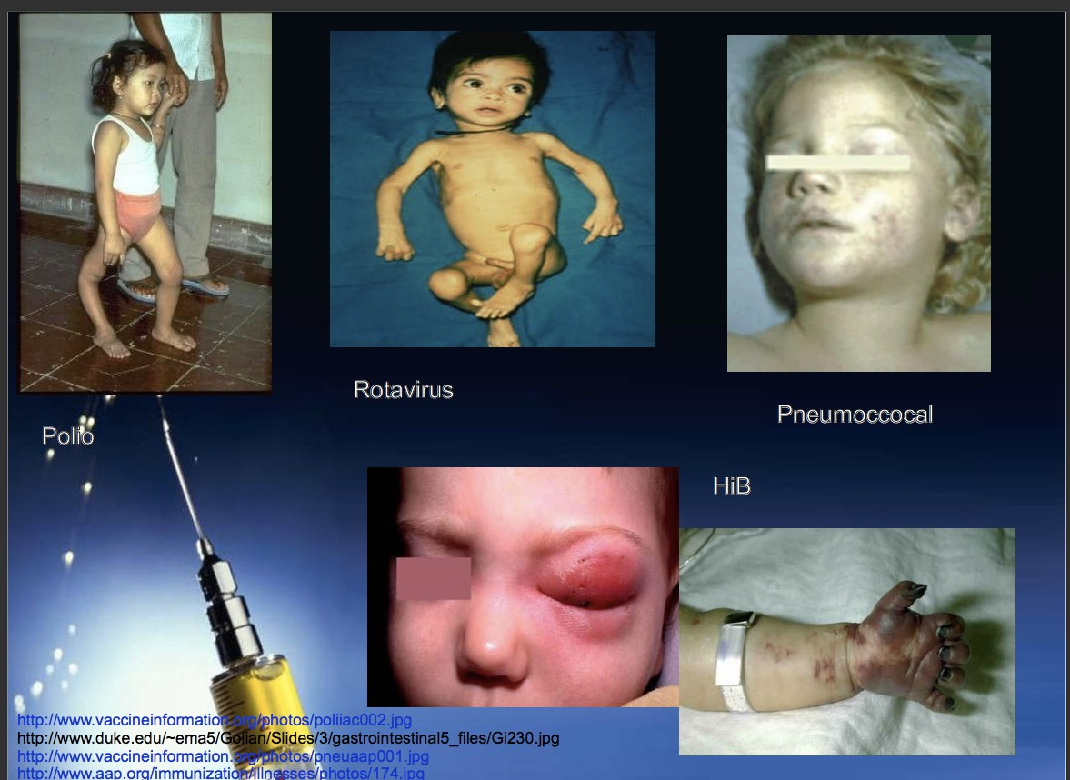

Slide 12
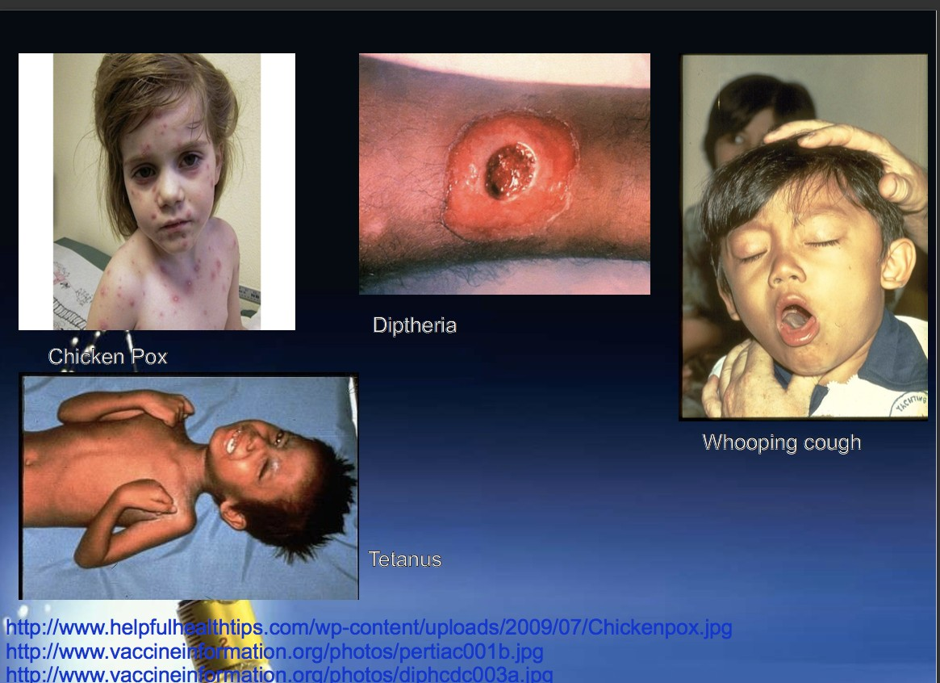

Slide 13
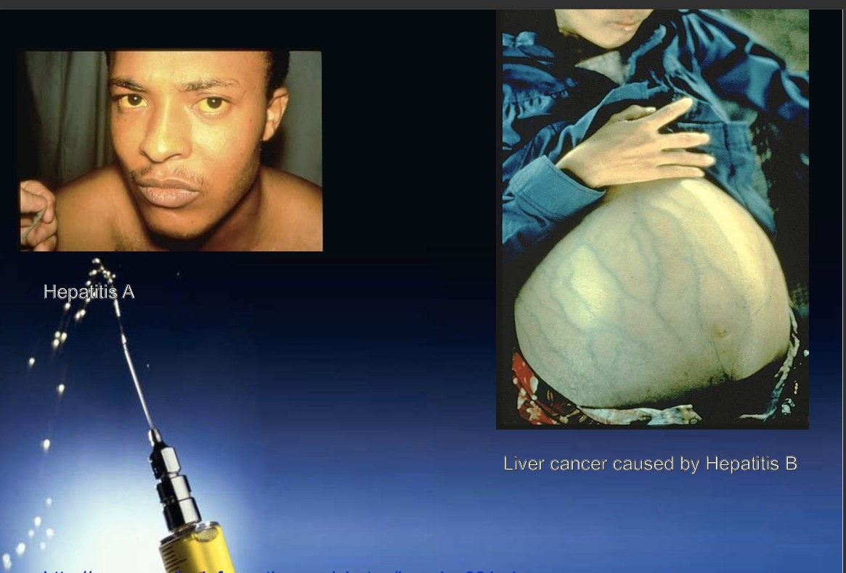

Slide 14
HOW VACCINE WORKS
Development of active immunity, Humoral or cell mediated or both.
Humoral immunity - by secretion of antiobodies from B- cells.
Cell mediated immunity - mediated by T- cells. Eg. In BCG, CMI & Delayed type of hypersensitivity.
Education of reticuloendothelial system of body and production of memory cells or primed cells by both B & T cells. That is devolopment of immunobiological memory.

Slide 15
COMMUNICABLE DISEASES AND VACCINES AVAILABLE
TB – BCG
Measle, Mumps, Rubella - MMR
Chicken Pox - Varicella
Diptheria, Tetanus, Pertussis (aka Whooping Cough) - DPT
Hepatitis (A and B) – HepA, HepB
Polio – OPV, IPV
Rotavirus – RVV
Pneumoccus – PCV
Haemophilus influenzae B- Hib

Slide 16
TYPES OF VACCINES
Live, attenuated vaccines
Inactivated vaccines
Subunit vaccines
Toxoids

Slide 17
LIVE VACCINES
Live, attenuated vaccines contain a version of the living microbe that has been weakened in the lab so it can’t cause disease.
Because a live, attenuated vaccine is the closest thing to a natural infection, these vaccines are
good “teachers” of the immune system.
Example: Vaccines against polio (OPV), measles, mumps, rubella and chickenpox

Slide 18
INACTIVATED VACCINES
Scientists produce inactivated vaccines by killing the disease-causing microbe with chemicals, heat, or radiation. Such vaccines are more stable and safer than live vaccines.
Because dead microbes can’t mutate back to their disease-causing state.
Example: Vaccines against influenza, inactivated polio vaccine, hepatitis A etc.

Slide 19
TOXOIDS
For bacteria that secrete toxins, or harmful chemicals, a toxoid might be the answer.
These vaccines are used when a bacterial toxin is the main cause of illness.
Scientists have found that they can inactivate toxins by treating them with formalin. Such “detoxified” toxins, called toxoids, are safe for use in vaccines.
Example: Diphtheria, Tetanus toxoid

Slide 20
SUBUNIT VACCINE
Instead of the entire microbe, subunit vaccines include only the antigens that best stimulate the immune system.
Because subunit vaccines contain only the essential antigens and not all the other molecules that make up the microbe.
Example: Plague immunization.

Slide 21
CELLULAR FRACTIONS
Meningococcal vaccine from the polysaccharide antigen of the cell wall.
Pneumococcal vaccine from the polysaccharide capsule of the organism.

Slide 22
The aim is to – simplify administration.
COMBINATIONS
- reduce costs
-minimise the no. of contacts with the health system.
Eg. DPT, DT, MMR, DPT& Hep.B, DPT, Hep B &
Hib, Hep A & B etc.

Slide 23
MAJOR CONSTITUENTS OF VACCINE
Active immunizing antigens-
  Live virus, killed bacteria, Toxoids
Suspending fluid-
  Sterile water, saline or tissue culture fluid.
Preservatives, stabilizers, & antibiotics-
  Thiomersal. Neomycin, kanamycin.
Adjuvants- Al salts frequently used.

Slide 24


